Slide 1
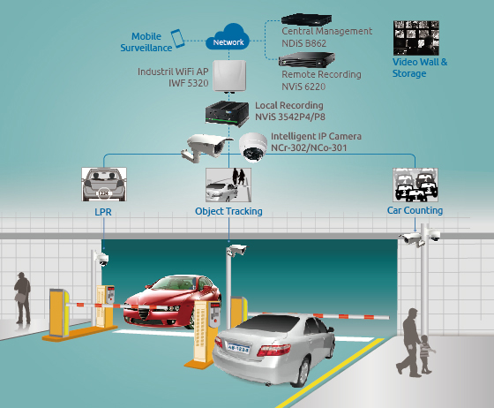
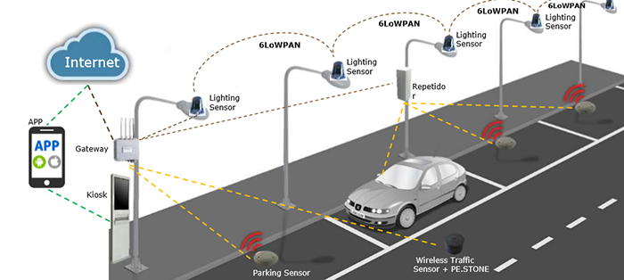
Future Works:
IoT Integration:
  Add Wi-Fi (like ESP8266) or Bluetooth modules to send distance data to a mobile app or cloud platform.
  View real-time or logged data remotely for better diagnostics and usage tracking.
Visual Alerts:
  Replace the LCD with an OLED display or a graphical interface to show parking proximity visually.
  Add a bar graph-style display or animated indicators for better user experience.
Voice Alerts:
  Include a voice module to give spoken instructions like “Obstacle Left - 20 cm” for blind spot assistance.

Slide 2
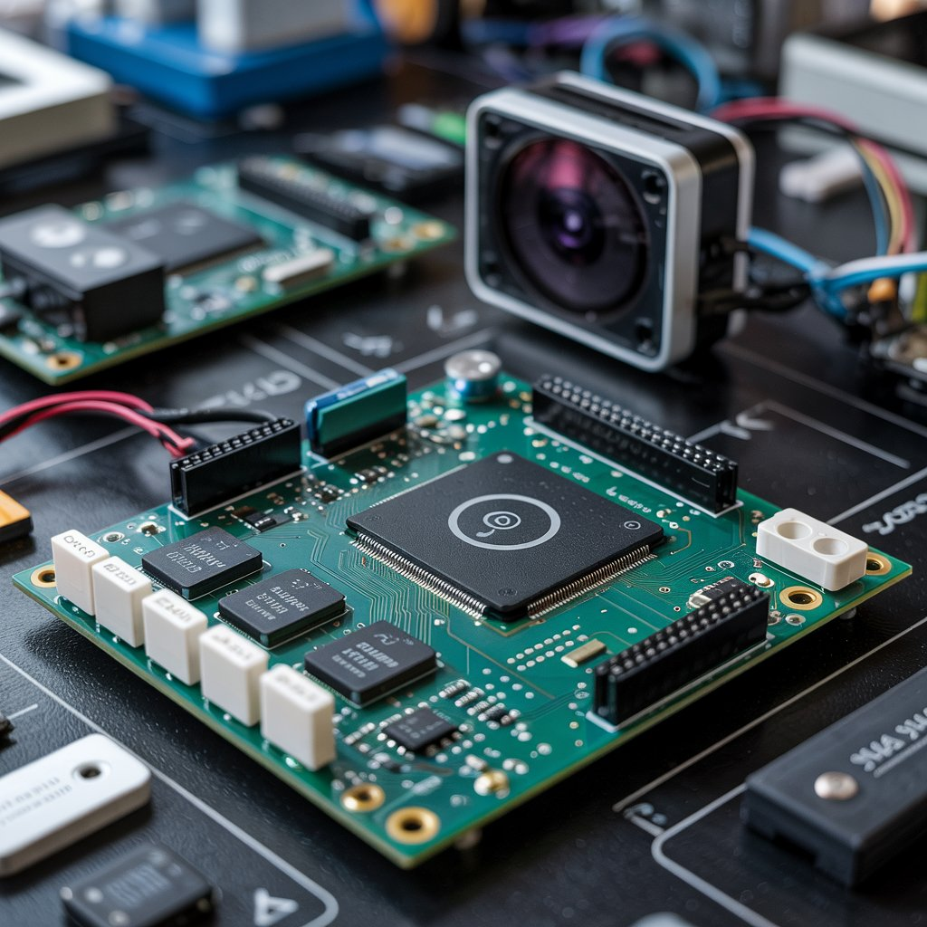
Motor or Servo Integration:
  Attach a servo motor for an automatic parking simulation, where the system guides or stops the vehicle based on distance.
Power Management:
  Upgrade to a battery-operated or solar-powered system to make it suitable for outdoor and mobile applications.
Modular PCB Design:
  Design a custom PCB for compactness and better component layout for real-world installation.
Advanced Detection:
  Use IR sensors or camera-based object recognition to detect smaller or low-profile objects that ultrasonics might miss.

Slide 3
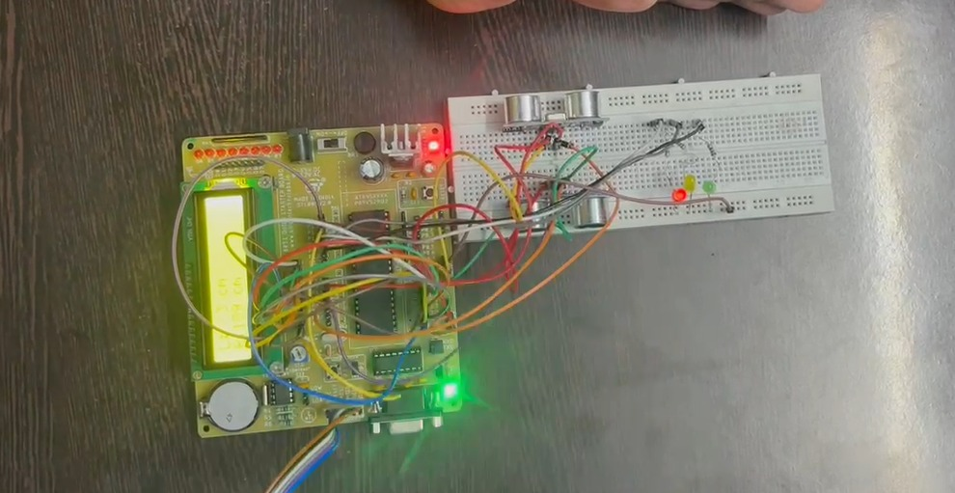
FULL RECAP:-
As you saw, this ultrasonic parking assistant is a simple yet powerful application of embedded systems. Using just a few components, we’ve built a system that mimics real car reverse sensors — measuring distance, giving visual feedback with LEDs.
It’s a great project for beginners in microcontrollers, electronics, or embedded C programming.
We can also try replacing the LCD with a 7-segment display or OLED to make it more compact.

